Slide 1


The code of conduct design of a company
NAME: JOY KARMOKAR
ID: 18-39263-3
DEPARTMENT: CSE
COURSE NAME: Engineering Ethics
COURSE CODE: EEE 3107
SECTION: C
SEMESTER: FALL 2021-22
Page- 1

Slide 2
LOCAL ENGINEERING, INC.
Company Type
Commercial Services
Residential Services
Civil Engineering
Home Inspections
Structural Engineering
House Plans
Conceptual Design
Stormwater Plans
Master Planning
Site Plans
JOY KARMOKAR
05/12/21
Page- 2

Slide 3

Our Company Specializing In
Construction And Engineering Design Services
Structural Engineering Services
Civil Engineering Services
Home Inspections
JOY KARMOKAR
05/12/21
Page- 3

Slide 4

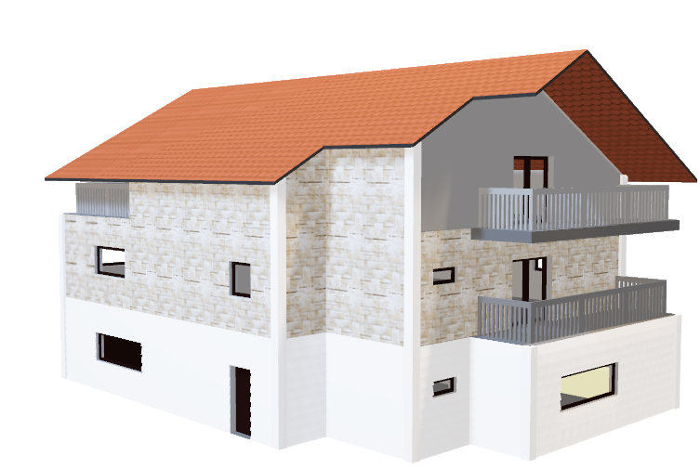
My Role In This Company
Civil Engineer
3D Control
JOY KARMOKAR
05/12/21
Page- 4

Slide 5
Code Of Ethics
To treat all persons fairly and with respect, and to not engage in discrimination based on characteristics such as race, religion, gender, disability, age, national origin, sexual orientation, gender identity or gender expression.
Public
Safety
To not engage in harassment of any kind, including sexual harassment or bullying behavior.
Public
Safety
JOY KARMOKAR
05/12/21
Page- 5

Slide 6
Code Of Ethics(Contd.)
Engineer can carry out their responsibilities in a manner to bring respect to the profession.
Economic
Engineer are be mindful that representatives of the community and shall represent the overall community interest.
Economic
JOY KARMOKAR
05/12/21
Page- 6

Slide 7
Code Of Ethics(Contd.)
To treat all persons fairly and with respect.
Social
To support colleagues and co-workers.
Social
JOY KARMOKAR
05/12/21
Page- 7

Slide 8
Code Of Ethics(Contd.)
To maintain the environment engineer have to make a proper way to make it clean.
Environmental
To avoid injuring others, their property, reputation, or employment by false or malicious actions, rumors or any other verbal or physical abuses
Environmental
JOY KARMOKAR
05/12/21
Page- 8

Slide 9
Code Of Ethics(Contd.)
Engineer have to be that much confident to forward the rules to the every kind of people.
Sustainability
To ensure that professional judgment is not influenced by a conflict of interest and, where such a conflict may exist.
Sustainability
JOY KARMOKAR
05/12/21
Page- 9

Slide 10

JOY KARMOKAR
05/12/21
Page- 10

Slide 11

THANK YOU
JOY KARMOKAR
05/12/21
Page- 11

